Slide 1
Use Case Diagrams

Slide 2
Static Modeling
Static Modeling is used to represent the static constituents of a Software such as :
1.Classes
2.Objects
3.Interfaces and
4.Their relationship with each other.

Slide 3
Dynamic Modeling
Dynamic Modeling is used to represent the behavior of the static constituents of a software , here static constituents includes, classes , objects, their relationships and interfaces
Dynamic Modeling also used to represents the interaction, workflow, and different states of the static constituents in a software

Slide 4
Structural Diagrams
• Class Diagram – set of classes and their relationships. Describes interface to the class (set of operations describing services)
• Object Diagram – set of objects (class instances) and their relationships
• Component Diagram – logical groupings of elements and their relationships
• Deployment Diagram - set of computational resources (nodes) that host each component

Slide 5
Behavioral Diagram
• Use Case Diagram – high-level behaviors of the system, user goals, external entities: actors
• Sequence Diagram – focus on time ordering of messages
• Collaboration Diagram – focus on structural organization of objects and messages
• State (Machine) Diagram – event driven state changes of system
• Activity Diagram – flow of control between activities

Slide 6
Use Cases
What is a Use Case
A formal way of representing how a business system interacts with its environment
Describes the system's actions from a the point of view of a user
A scenario-based technique in the UML

Slide 7
Use Case Descriptions
• actors - something with a behavior or role, e.g., a person, another system, organization.
• scenario - a specific sequence of actions and interactions between actors and the system, a.k.a. a use case instance
• use case - a collection of related success and failure scenarios, describing actors using the system to support a goal.

Slide 8
Use Case Componentss
The use case has three components.
The use case task referred to as the use case that represents a feature needed in a software system.
The actor(s) who trigger the use case to activate.
The communication line to show how the actors communicate with the use case.

Slide 9
Component - Use Cases
A use case is a summary of scenarios for a single task or goal.
An actor is who or what initiates the events involved in the task of the use case. Actors are simply roles that people or objects play.
So as we read our scenario, what or who is the actor????

Slide 10
Component - Actor
🡪 Include all user roles that interact with the system
🡪Include system components only if they responsible for initiating/triggering a use case.
-- For example, a timer that triggers sending of an e-mail reminder
🡪primary actor- a user whose goals are fulfilled by the system
importance: define user goals
🡪supporting actor - provides a service (e.g., info) to the system
importance: clarify external interfaces and protocols

Slide 11
Component - Actors
External objects that produce/consume data:
• Must serve as sources and destinations for data
• Must be external to the system .
It can be a:
Human, Machines , Organizations
Peripheral device (hardware)
External system or subsystem
Time or time-based event
Represented by stick figure
Notes:
Actors
Are NOT a part of the system (external to the system)
A single actor may represent multiple physical users
Whether human or not, represented by stick figure
MUST label stick figure with the name of the actor

Slide 12
Questions for Identifying People Actors
Who is interested in the scenario/system?
Where in the organization is the scenario/system be used?
Who will benefit from the use of the scenario/system?
Who will supply the scenario/system with this information, use this information, and remove this information?
Does one person play several different roles?
Do several people play the same role?
Notes:
Actors
7) Does one person play several different roles?
May have an actor for each role
8) Do several people play the same role?
Only use one actor per role (no matter how many people play that role)
Identifying actors is an iterative process
Defining how an actor interacts with the system may clarify whether there are duplicate actors or not

Slide 13
Use Case
Each use case in a use case diagram describes one and only one function in which users interact with the system
May contain several “paths” that a user can take while interacting with the system
Each path is referred to as a scenario
Notes:
Use Case
In reading a use case, you should not be able to tell if an activity is computerized or manual
Used to document the current system (AS-IS system) or the new system being developed (TO-BE system)
Communicates at a high level what the system needs to do
Captures the typical interaction of the system with the system’s users
Logical model
Physical details are defined during the design phase

Slide 14
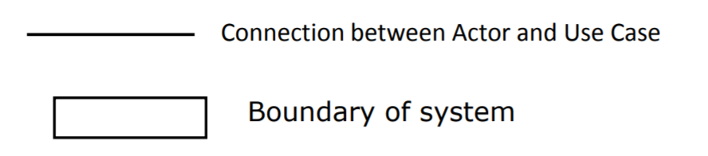
Component- Relationships
Relationships
Represent communication between actor and use case
Depicted by line or double-headed arrow line
Also called association relationship
Notes:
Use Case Relationship
Association relationship
May exist between actor and a use case
Often referred to as a communicate association
Navigable in both directions (actor to use case and use case to actor)
Some use just a line
Others use a double-headed arrowhead
Navigable in only one direction (actor to use case OR use case to actor)
Use a arrowhead where arrowhead denotes the direction of communication
Navigation direction of an association represents who is initiating the communication
Multiplicity
Not consistency shown on all use-case diagrams (Some do; some don’t)

Slide 15
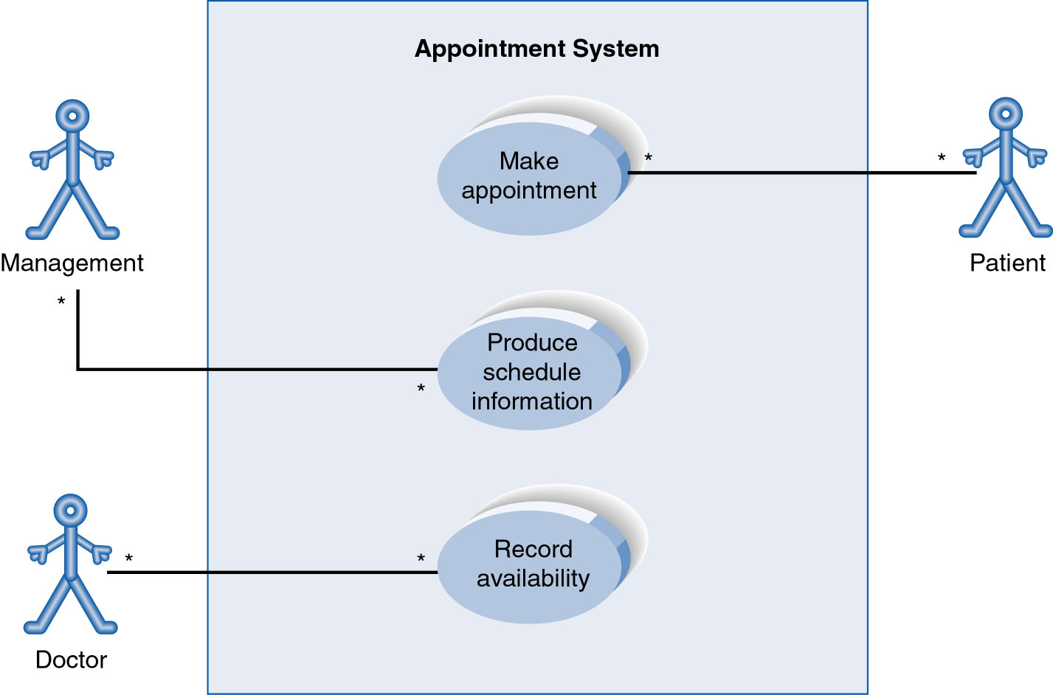
Use-Case Diagram
A use case diagram is a collection of actors, use cases, and their communications.
Notes:
Example Use Case
ACTORS
Represented by a stick figure
named
USE CASE
Represented by an oval
Named (POORLY NAMED; should be verb phrase)
RELATIONSHIP
2-way association

Slide 16
Linking Use Cases
• Association relationships
• Generalization relationships
One element (child) "is based on" another element
(parent)
• Include relationships
• One use case (base) includes the functionality of
another (inclusion case)
• Supports re-use of functionality
• Extend relationships
• One use case (extension) extends the behavior of
another (base)

Slide 17
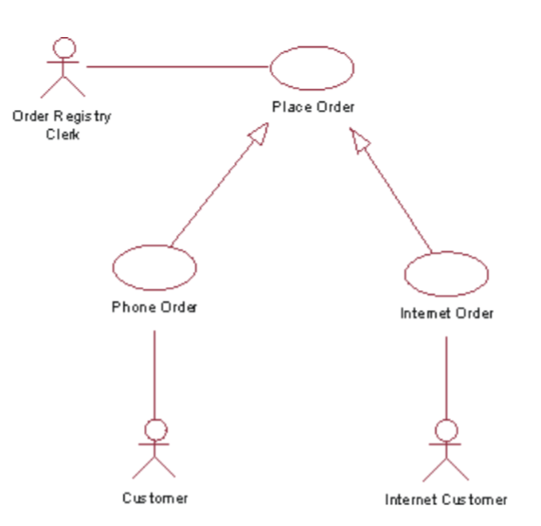
Generalization
The child use case inherits the behavior and meaning of the parent use case.
The child may add to or override the behavior of its parent
The actor Order Registry Clerk can instantiate the general use case Place Order.
Place Order can also be specialized by the use cases Phone Order or Internet Order.

Slide 18
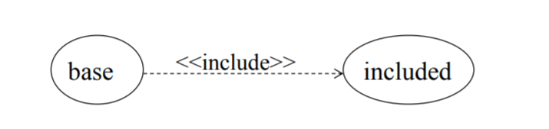
include
The base use case explicitly incorporates the behavior of another use case at a location specified in the base.
The included use case never stands alone. It only occurs as a part of some larger base that includes it.
Example:Login UC includes User Authentication UC);
to Authorize Car Loan (standard use case), a clerk must run Check Client’s Credit History (include use case)

Slide 19
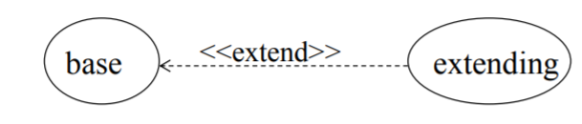
extend
The base use case implicitly incorporates the behavior of another use case at certain points called extension points.
The base use case may stand alone, but under certain conditions its behavior may be extended by the behavior of another use case.

Slide 20
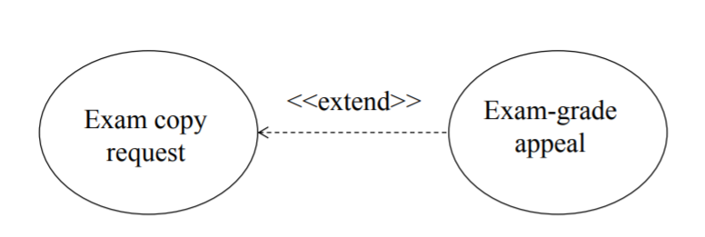
extend
linking an optional use case to a standard use case. Extend relationship
• Example: Register Course (standard use case) may have Register for Special Class (extend use case) – class for non-standard students, in unusual time, with special topics, requiring extra fees…).

Slide 21
How to create use case diagram
List main system functions (use cases) in a column:
– think of business events demanding system’s response
– users’ goals/needs to be accomplished via the system
– Create, Read, Update, Delete (CRUD) data tasks
– Naming use cases
– user’s needs usually can be translated in data tasks
Draw ovals around the function labels
Draw system boundary
Draw actors and connect them with use cases (if more intuitive, this can be done as step 2)
Specify include and extend relationships between use cases (yes, at the end - not before, as this may pull you into process thinking, which does not apply in UC diagramming)

Slide 22
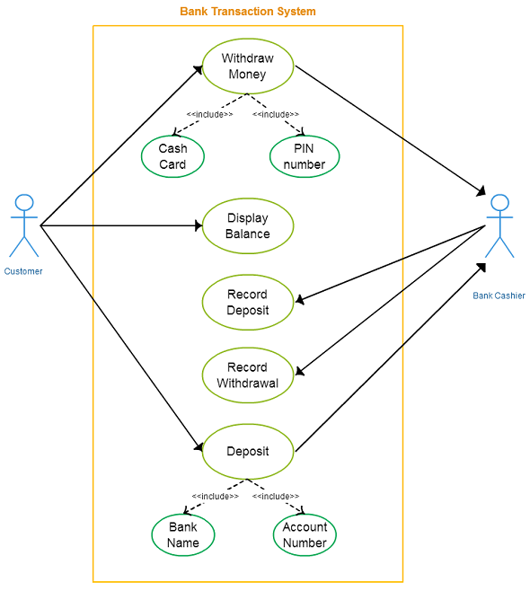

Slide 23
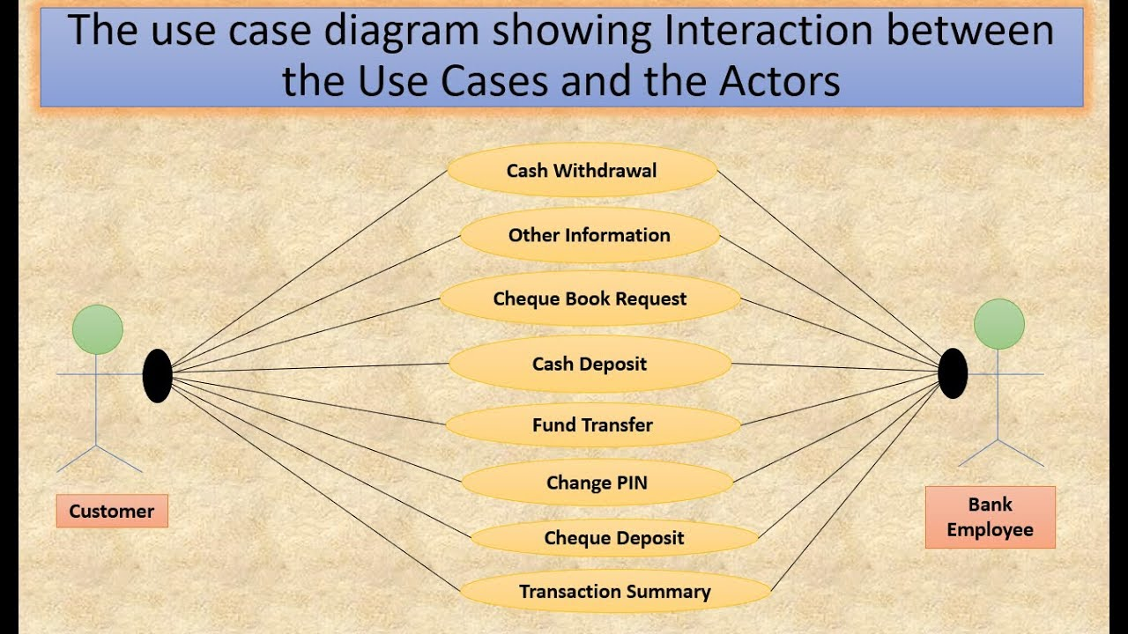

Slide 24
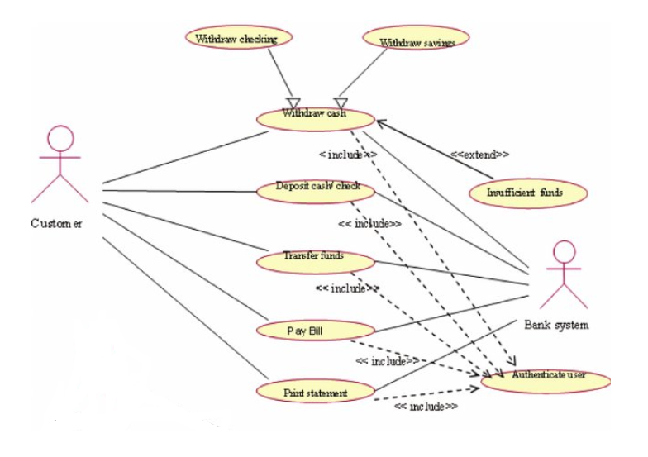

Slide 25
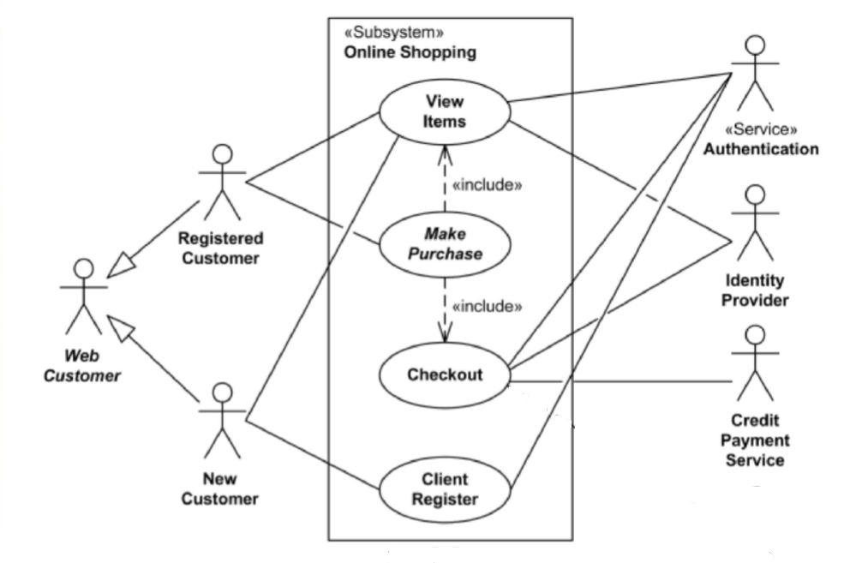
Online Shopping Website – Basic Use case

Slide 26
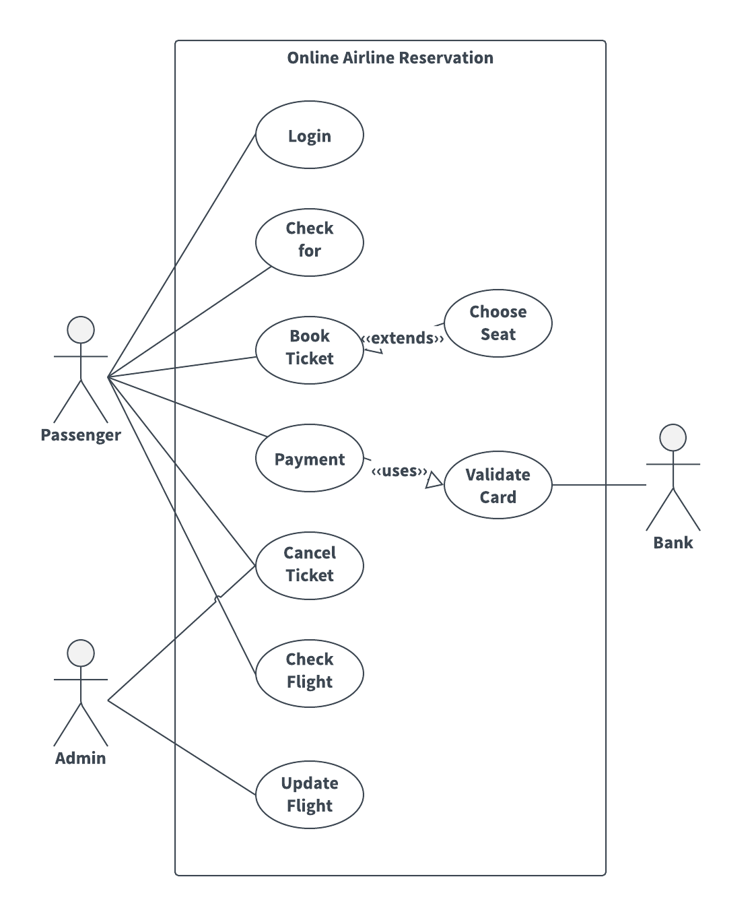

Slide 27
